Slide 1


Who are we?
Jacob M Delgado
Sebastian O Espinosa
Ricardo A Morell
Notes:
Greetings! We’re part of the Edge Computing Group at the University of Puerto Rico Mayaguez. Our mission is to create, sustainable and accessible AI-driven technology that positively impacts society. Specifically, our current work focuses on leveraging AI technology for healthcare applications in resource constrained environments

Slide 2
Who are we?
Jacob M Delgado
Sebastian O Espinosa
Ricardo A Morell
Notes:
Greetings! We’re part of the Edge Computing Group at the University of Puerto Rico Mayaguez. Our mission is to create, sustainable and accessible AI-driven technology that positively impacts society. Specifically, our current work focuses on leveraging AI technology for healthcare applications in resource constrained environments

Slide 3
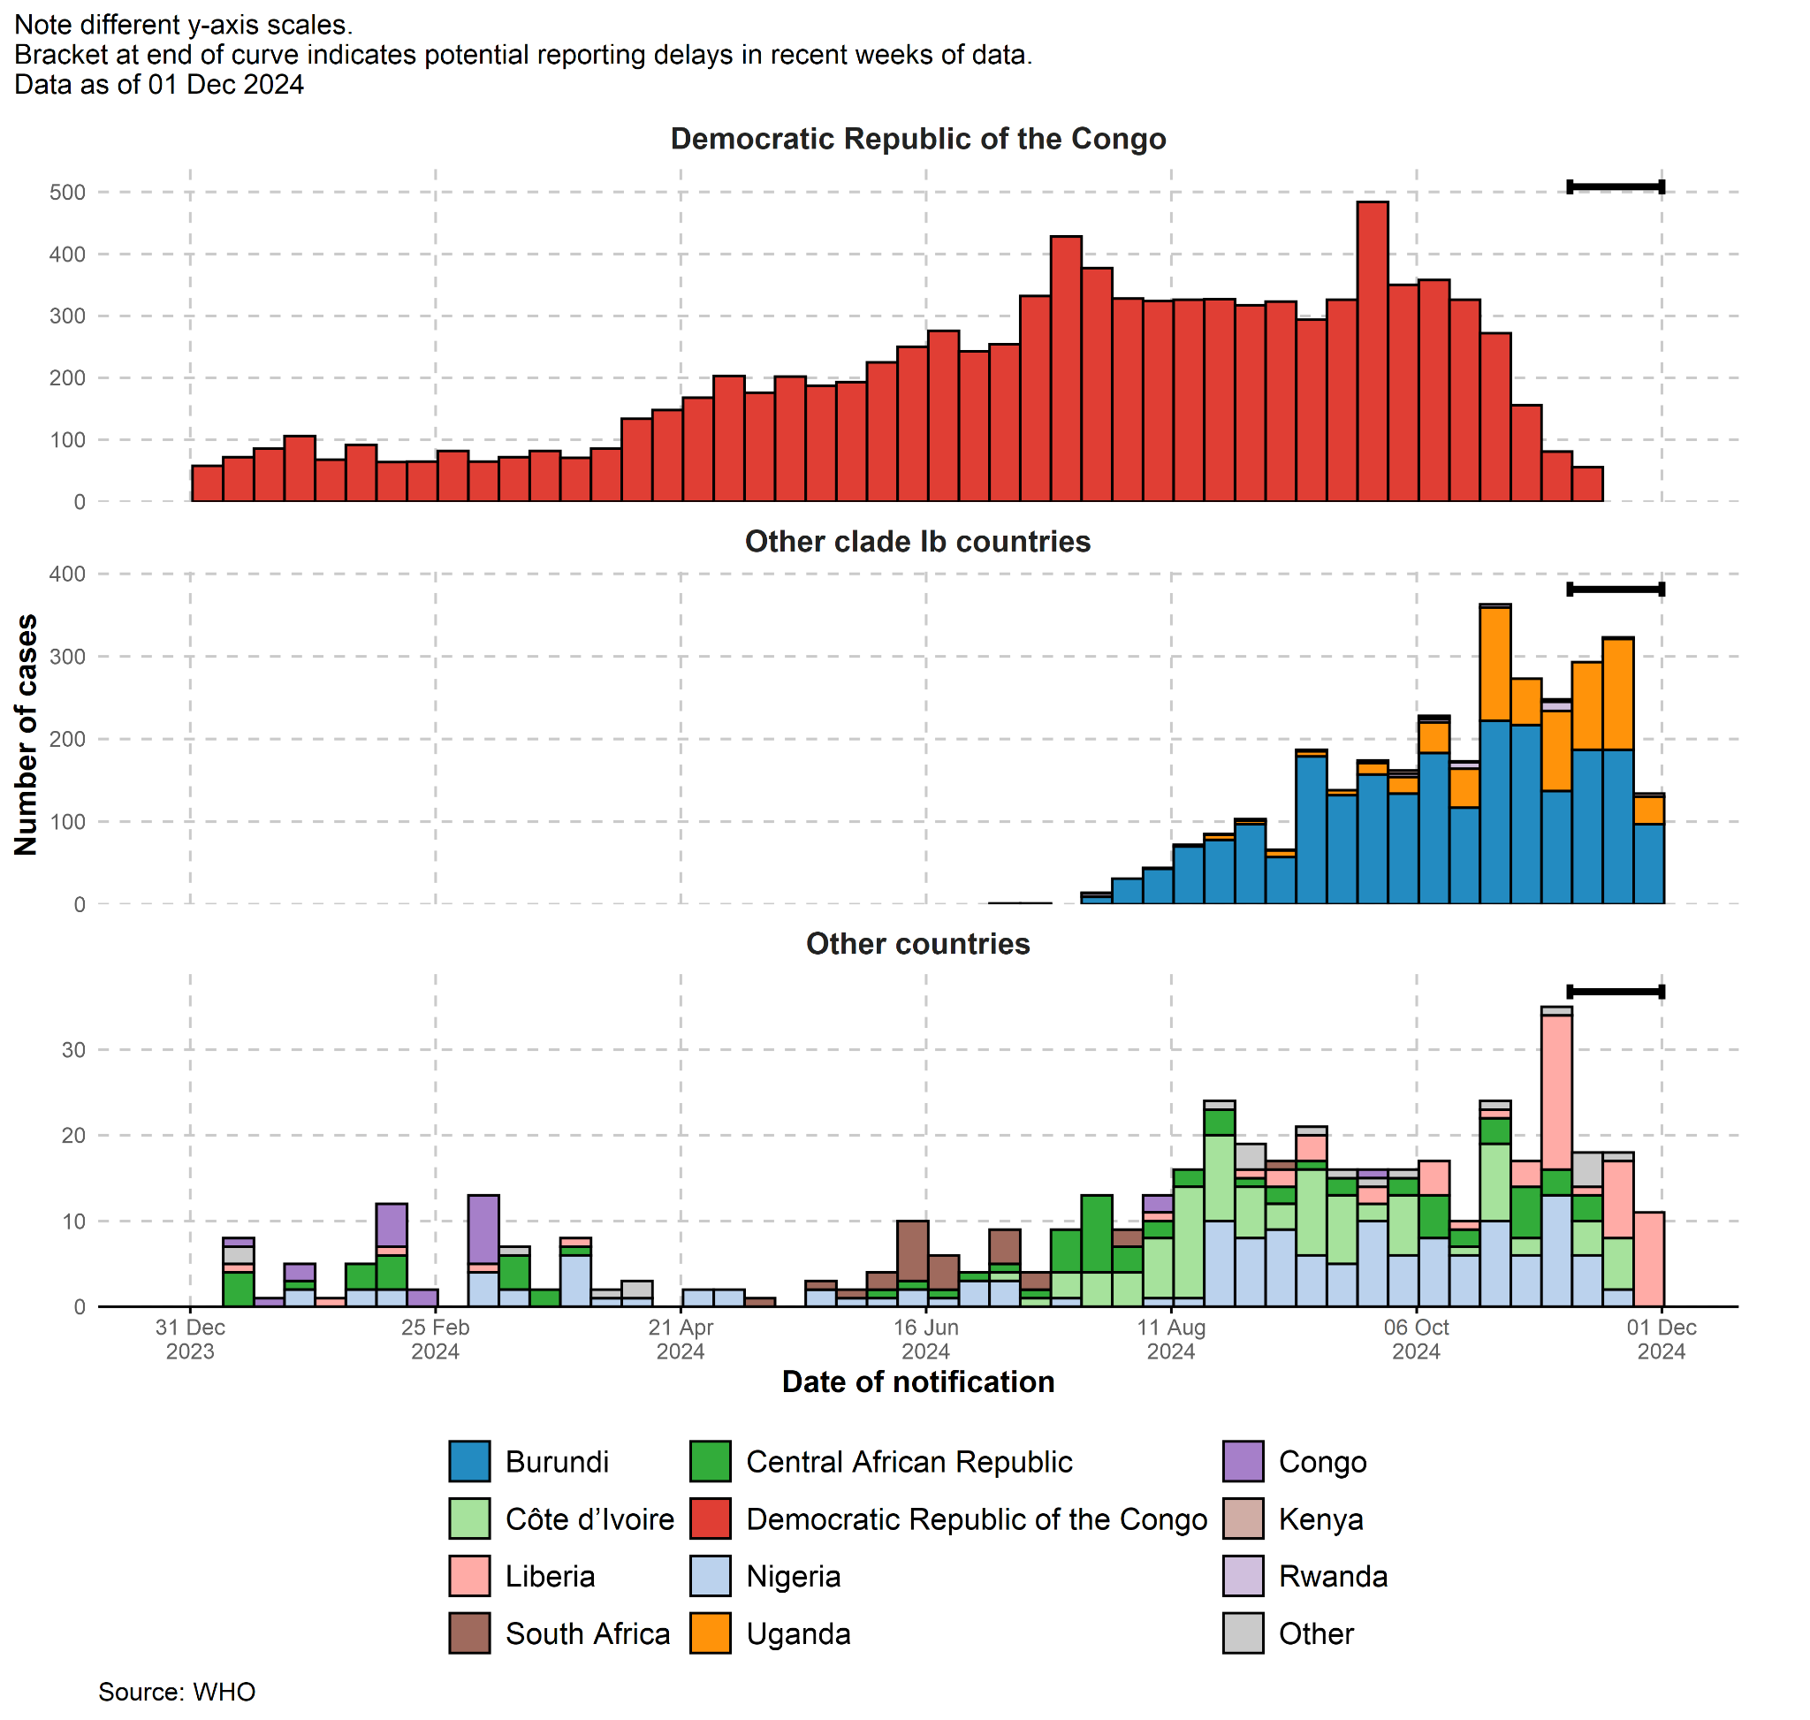
Overview
Outbreak of Monkeypox cases since 2022.
Real time polymerase chain reaction (PCR) and DNA test for detecting Monkeypox.
Notes:
"In recent years, the resurgence of monkeypox, or Mpox, has posed a significant public health challenge. Outbreaks have been reported across multiple countries, highlighting the need for rapid, accurate diagnosis to control the spread of the disease. Currently, the most reliable diagnostic tools include PCR tests and blood tests, which are considered the standard. While effective, these methods are far from ideal—they’re costly, time-consuming, and require access to specialized labs, which are often unavailable in low-resource settings."

Slide 4
The Problem
PCR tests isn’t readily available at all times.
PCR and blood tests aren’t accurate in all stages of monkeypox.
PCR and blood tests take too long to diagnose.
1
2
3
Notes:
"These existing methods have several major limitations. First, the cost—PCR tests can run up to $175 per test, making them inaccessible for many, especially in low-income regions. Second, the wait time—results can take anywhere from 3 to 7 days, delaying treatment and containment efforts. Third, accuracy—PCR test reliability varies depending on when the sample is collected in the disease's progression, increasing the likelihood of false positives or negatives. For regions without sufficient healthcare infrastructure, these barriers make timely and effective diagnosis nearly impossible, putting vulnerable populations at greater risk."

Slide 5
Solutions
Leverage AI Model
Use Edge Systems
Access through multiple devices
Notes:
"To address these issues, we’ve developed an AI-powered diagnostic tool that uses computer vision to analyze images of Mpox skin lesions. This solution employs a lightweight, efficient machine learning model deployed on an embedded system like the Jetson Orin. It enables real-time, on-device analysis of images captured via a smartphone or standard camera, eliminating the need for centralized labs or high-end computational resources. The tool is specifically designed for resource-constrained environments, offering a fast, accessible, and reliable way to diagnose Mpox."

Slide 6

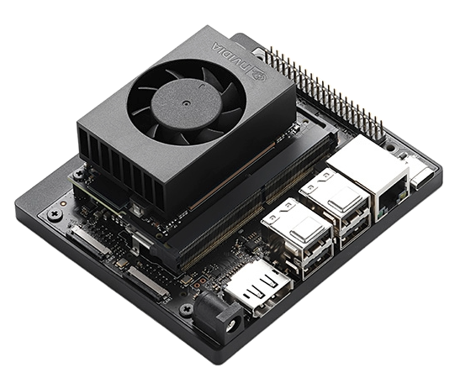
Benefits
Low Power
Real Time
Easy Access
Reliable
Notes:
"Our solution provides several transformative benefits. It significantly reduces diagnosis time, delivering results in seconds rather than days, enabling faster treatment and containment. It’s cost-effective, drastically lowering the expense per test, making it accessible to low-income and underserved communities. It’s also highly portable and user-friendly, requiring only basic hardware like a smartphone and the embedded system. By empowering healthcare providers with this tool, we not only improve outcomes for Mpox patients but also set the stage for scalable AI-based diagnostics for other diseases in the future."

